Slide 1
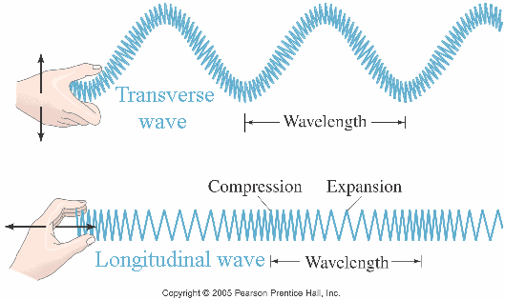
T-Chart
Transverse Vs. Longitudinal

Slide 2
Transverse Wave
And Energy

Slide 3
Longitudinal Wave
And Energy

Slide 4
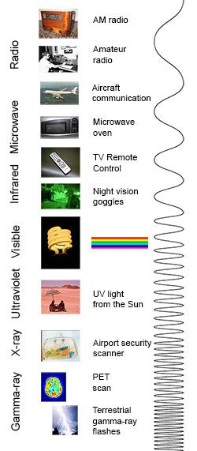
Transverse Wave
Examples: Water Waves, Light Waves, Electromagnetic Waves

Slide 5
Longitudinal Waves Examples: Sound Waves
https://www.youtube.com/watch?v=Ude8pPjawKI

Slide 6
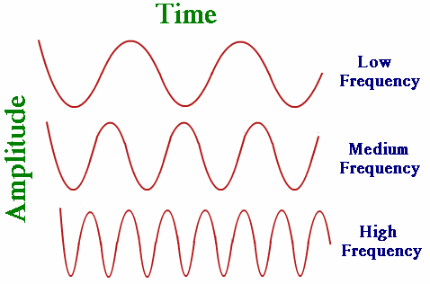
Transverse Wave
Wavelength is measured Crest to Crest or Trough to Trough.

Slide 7
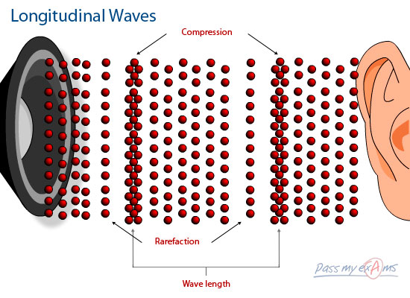
Longitudinal Wave
Wavelength is measured from Compression to Compression.
Compression is the point in a medium when the energy of a longitudinal wave pushes the particles close together into a dense area.
Rarefaction is the point in a medium of a longitudinal wave when the particles are less densely packed.

Slide 8
Transverse Wave

Slide 9
Longitudinal Wave

Slide 10
Both
ENERGY is transferred!! Energy moves through a wave, NOT matter!

Slide 11
Closing Question
Which travels faster: Light or Sound?

